Slide 1

Online shopping WEBSITE
By:

Slide 2


Introduction
Problem Statement
Objectives of Online Shopping
Functionalities of Online Shopping
DFD (Data Flow Diagram)
Implementation Details
Screenshots
Conclusion

Slide 3
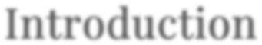

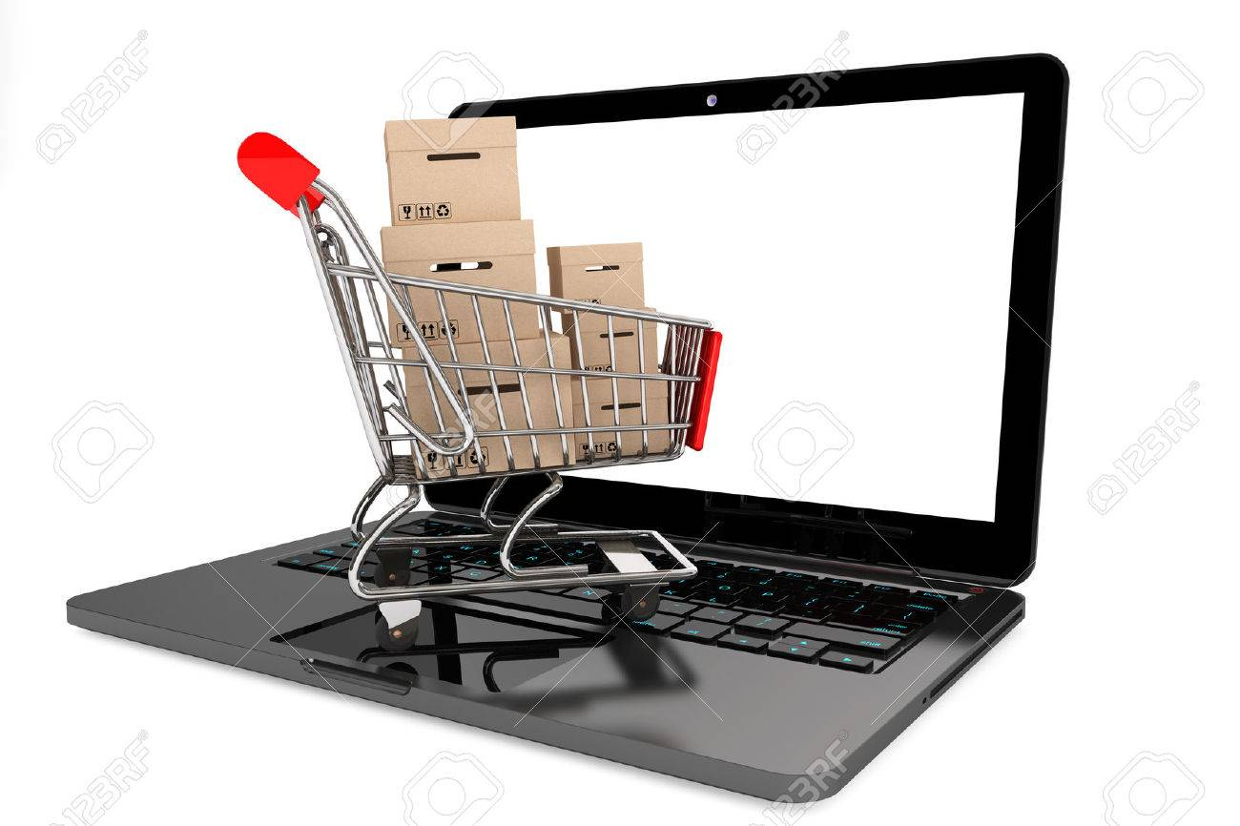
The ONLINE SHOPPING SYSTEM project mainly focuses on basic operations adding new product, new member and updating new information , searching product and members and facility to online shopping.
online SHOPPING SYSTEM project e-commerce website from where people can buy products online.

Slide 4
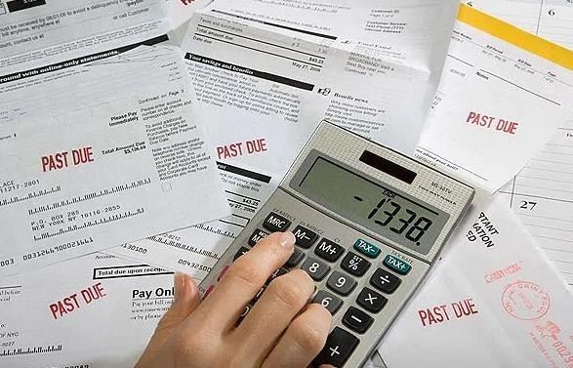
Problem of Online Shopping
Lack of shopping experience.
Lack of interactivity and close examination.
Shipping and handling cost.

Slide 5
Objectives of Online Shopping
The objective of the Shopping systems is to increase the point of customer choice.
Make an easy to use environment for users.
Reduce time used in shopping
Efficiency in buying product
Add and maintain records of available/new products.
Add and maintain employee details.

Slide 6
Functionalities of Online Shopping Website
Admin Module:
The admin has to first login himself/herself with the registered email ID and password to access functionalities of administrator.
Admin can use all functionalities on admin panel like ‘Add Product ’ ,‘Add Category of Product ’,‘Order Details ’,‘Add Cart’, ‘Add Items detail's’, ‘Edit Items’, ’Change Password’ and ‘logout’.

Slide 7
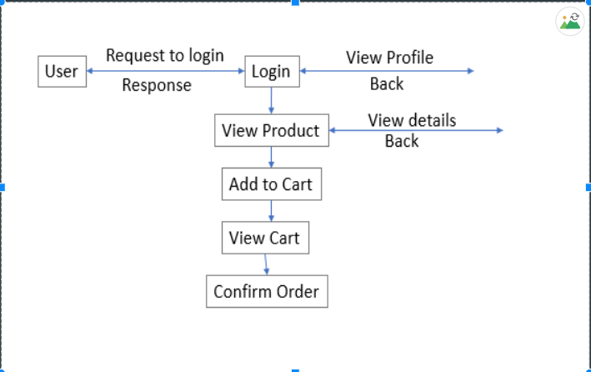
DFD- for user login

Slide 8
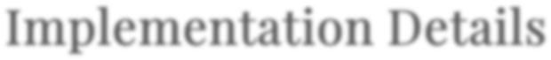

HTML 5
CSS 3
JavaScript
jQuery
Bootstrap
PHP
MySQL
Xampp Server- For database

Slide 9
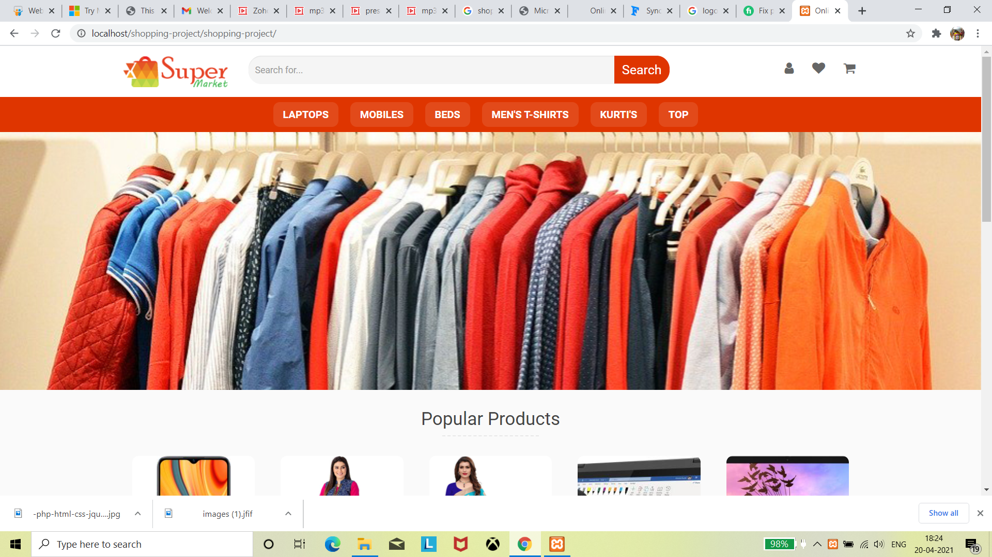
Home page

Slide 10
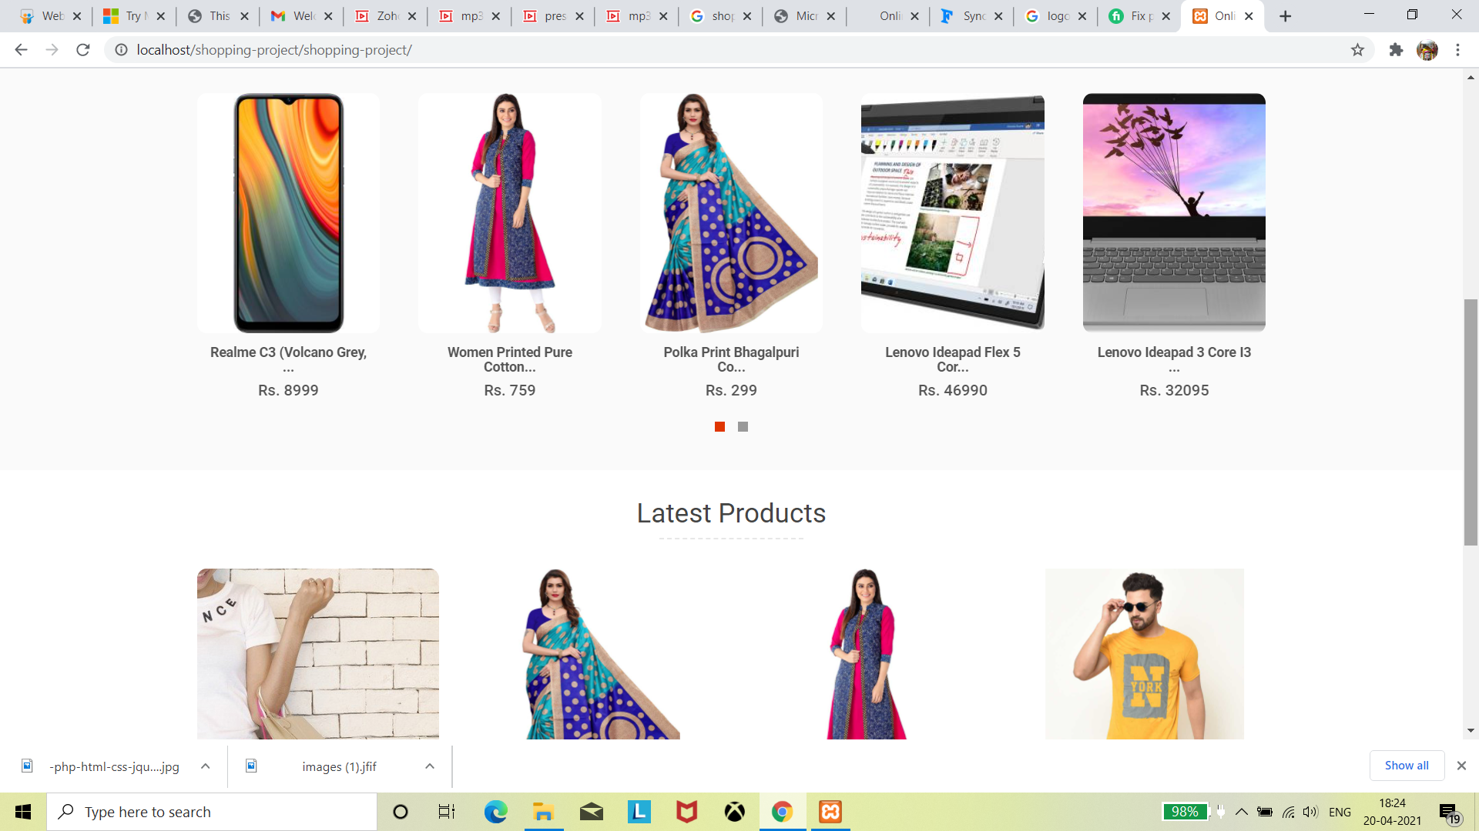

Slide 11
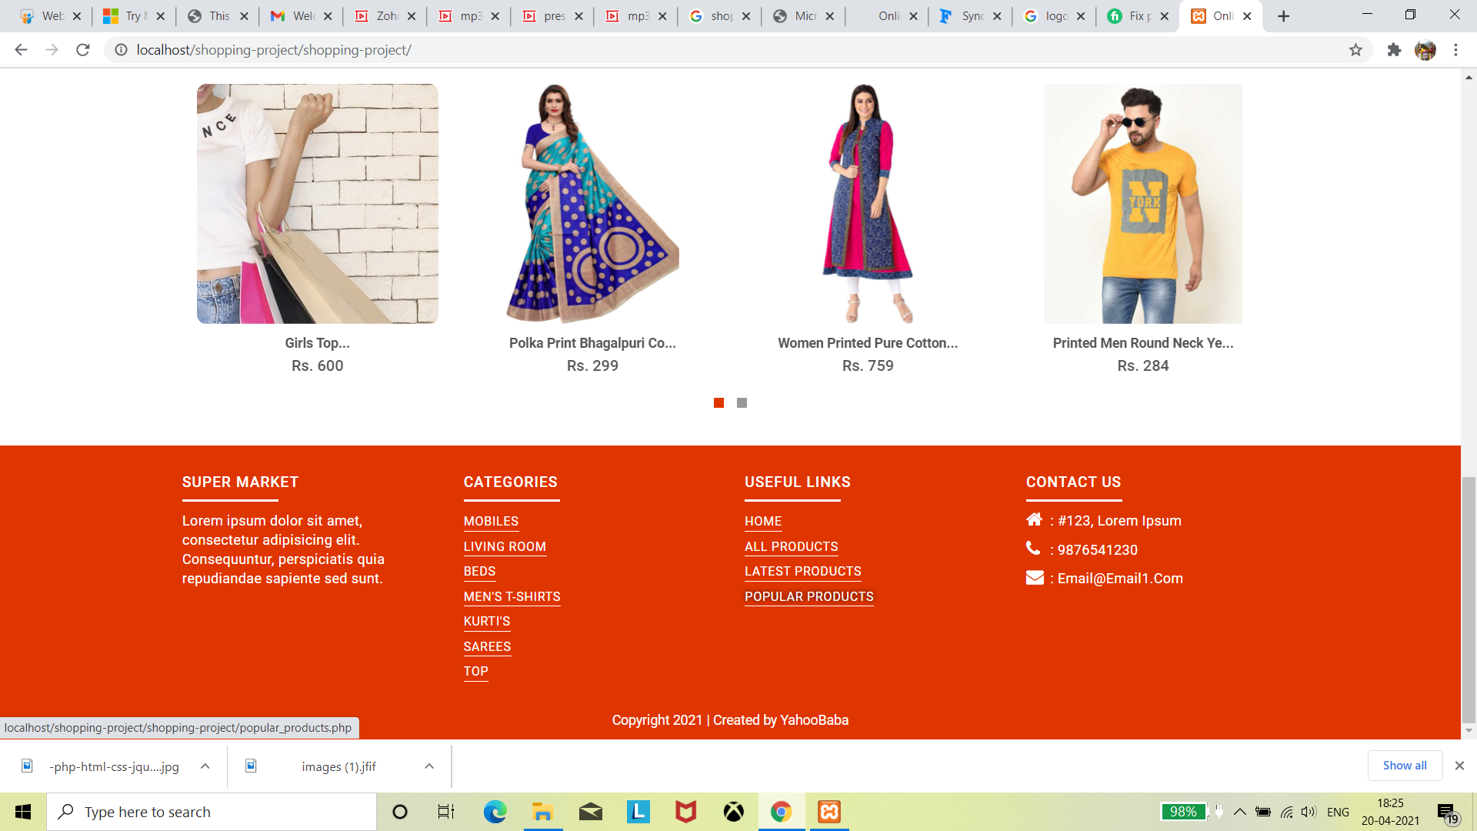

Slide 12
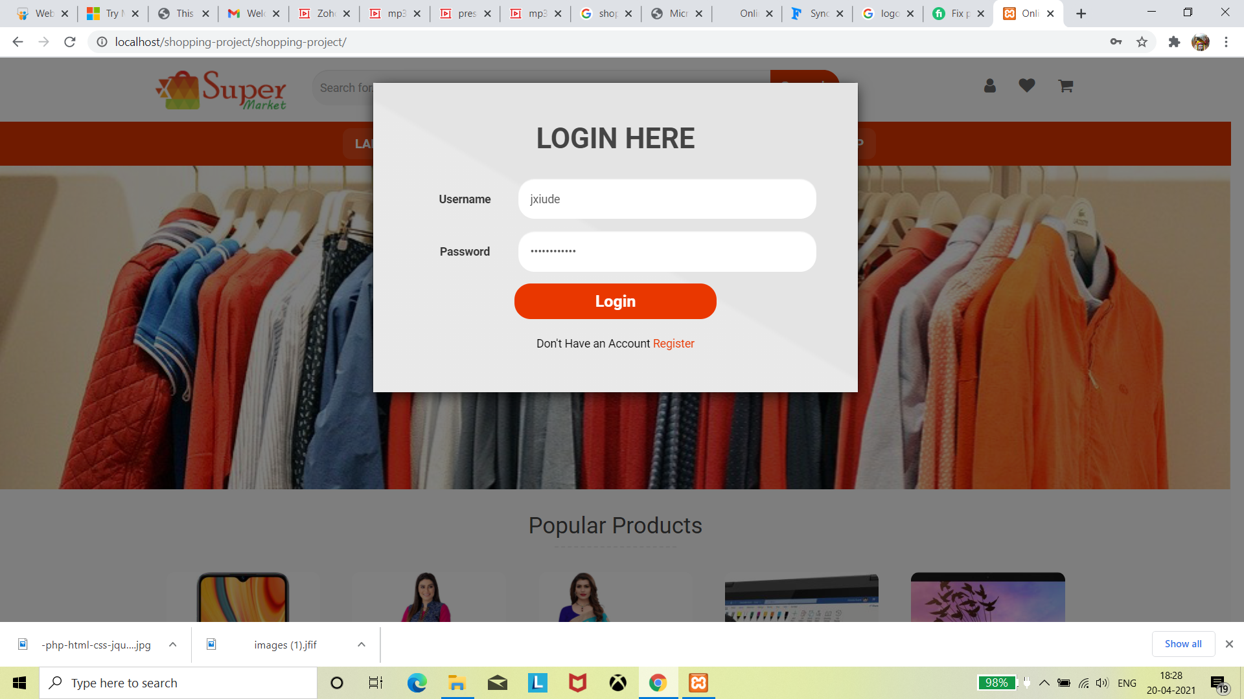
Login here

Slide 13
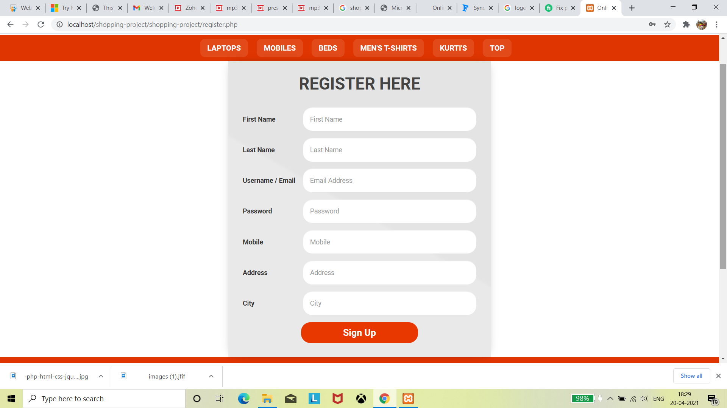
Register here

Slide 14
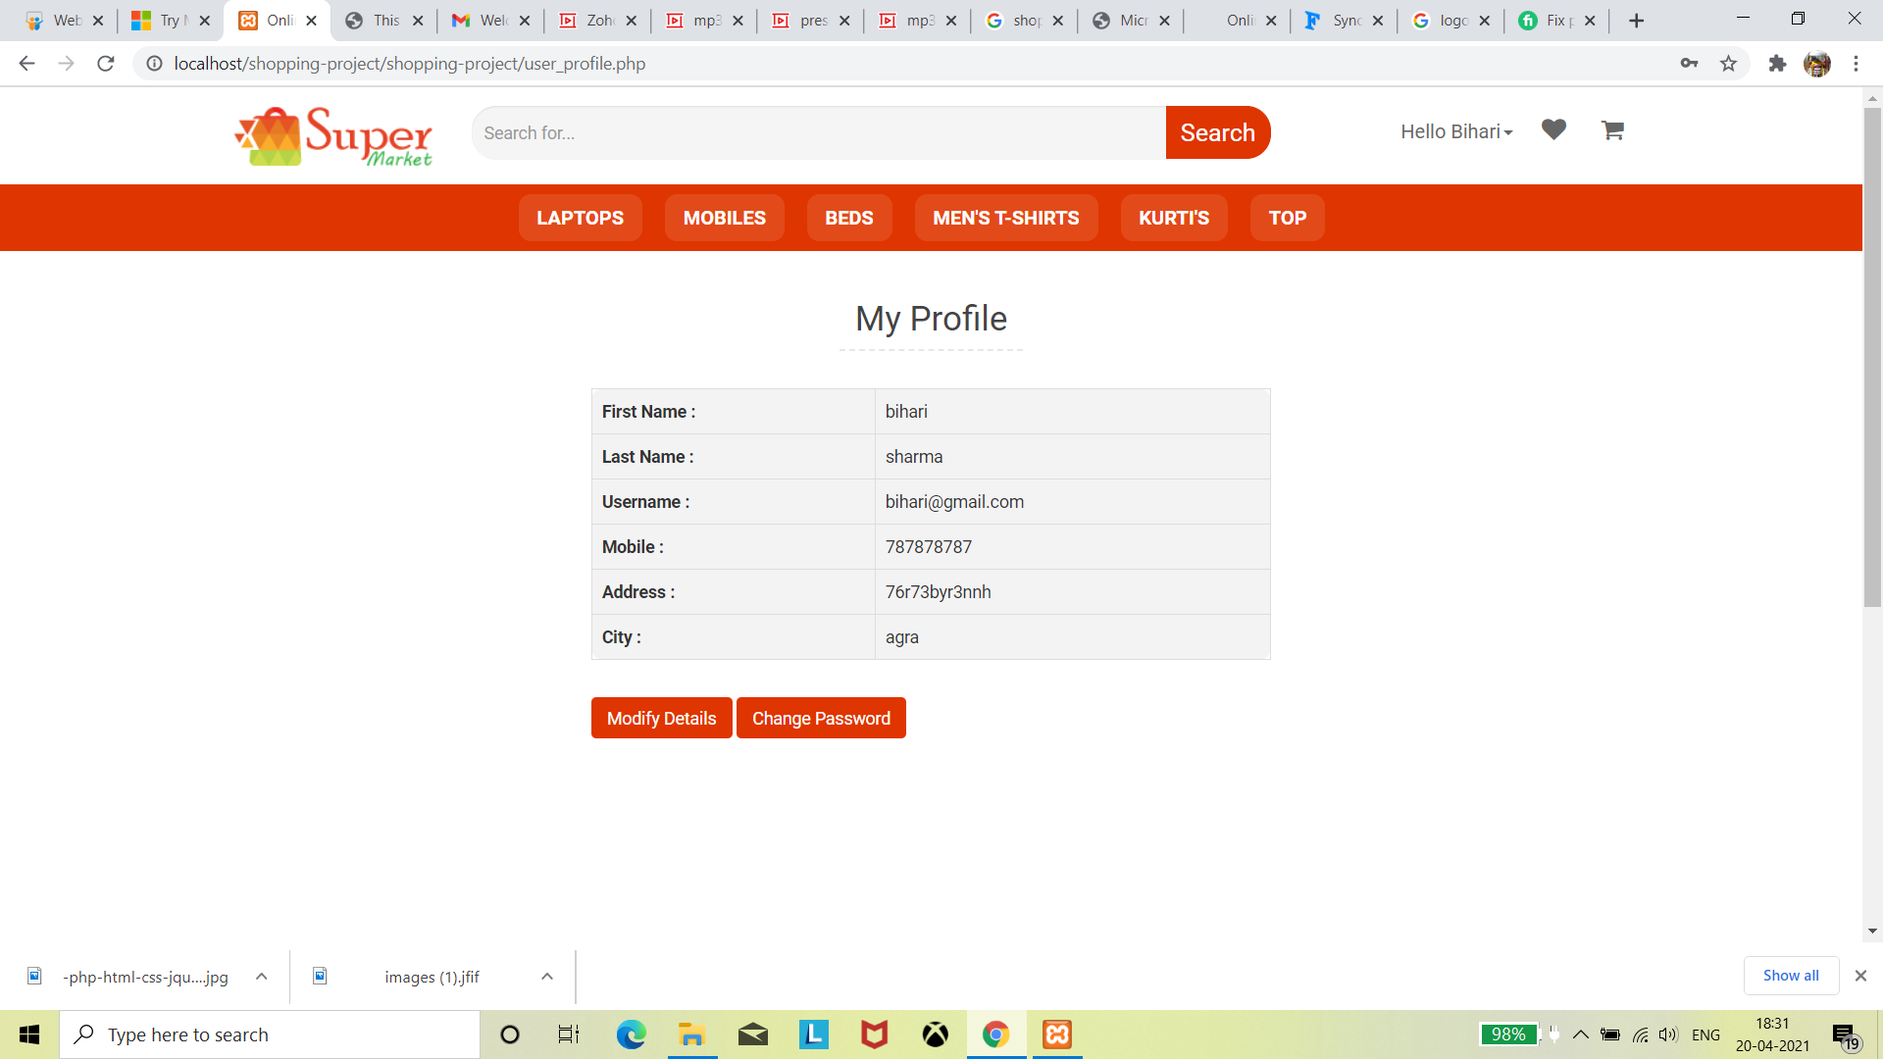
Profile of user

Slide 15
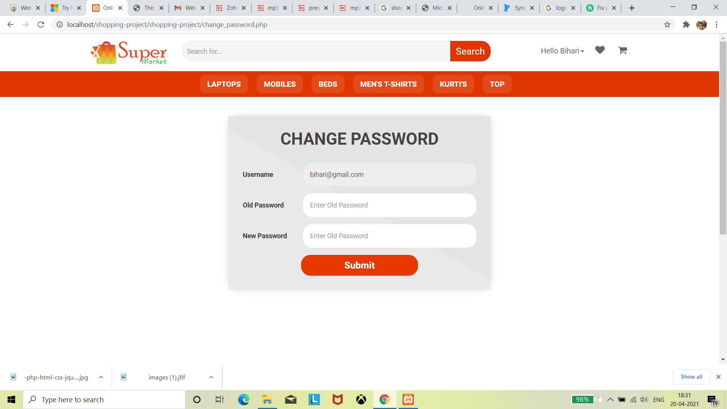
Change Password

Slide 16
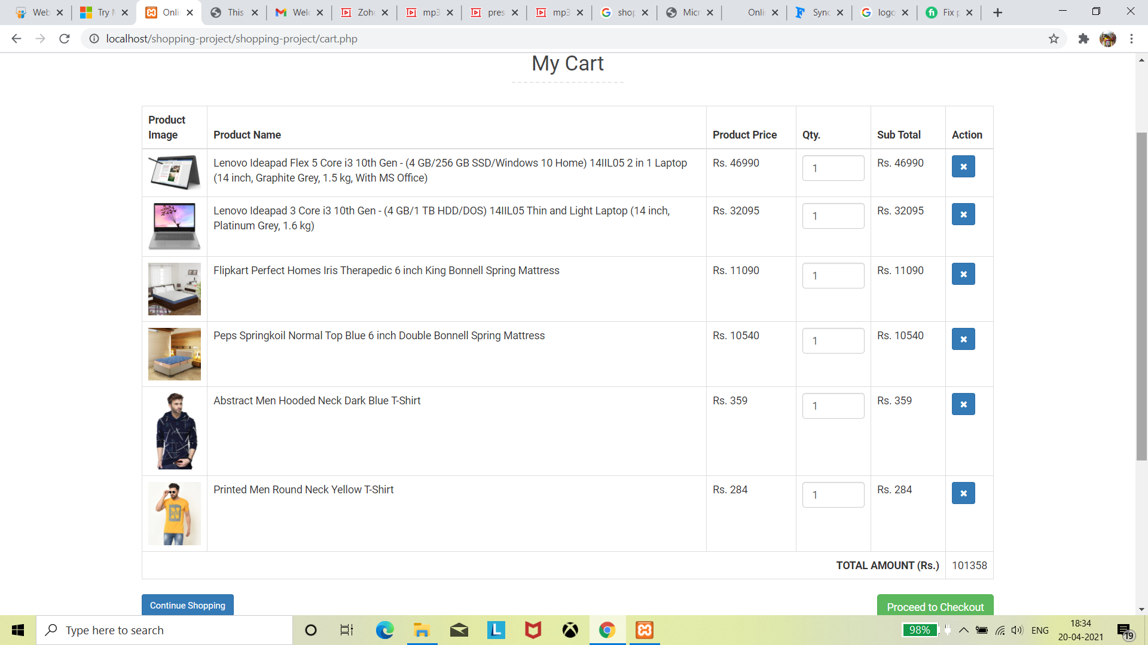
My Cart

Slide 17
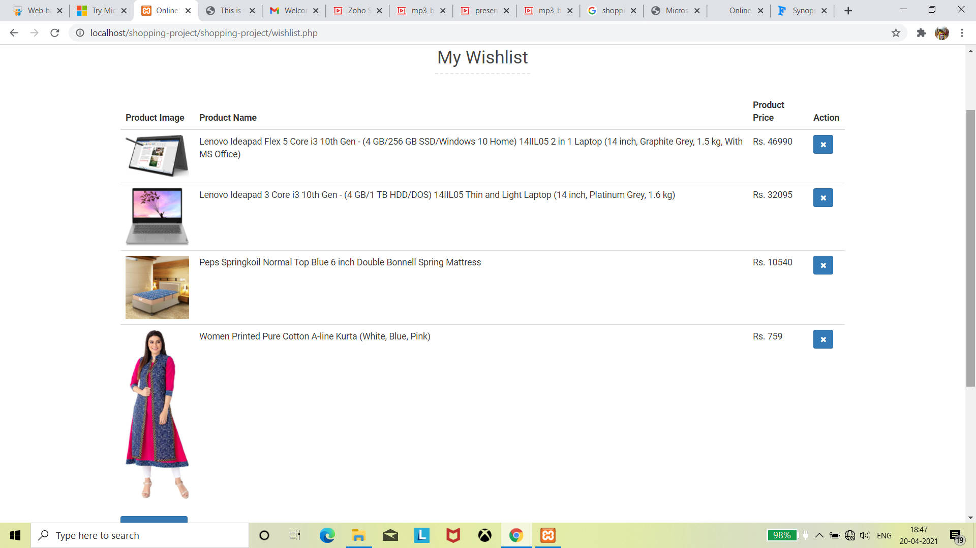
My Wishlist's

Slide 18
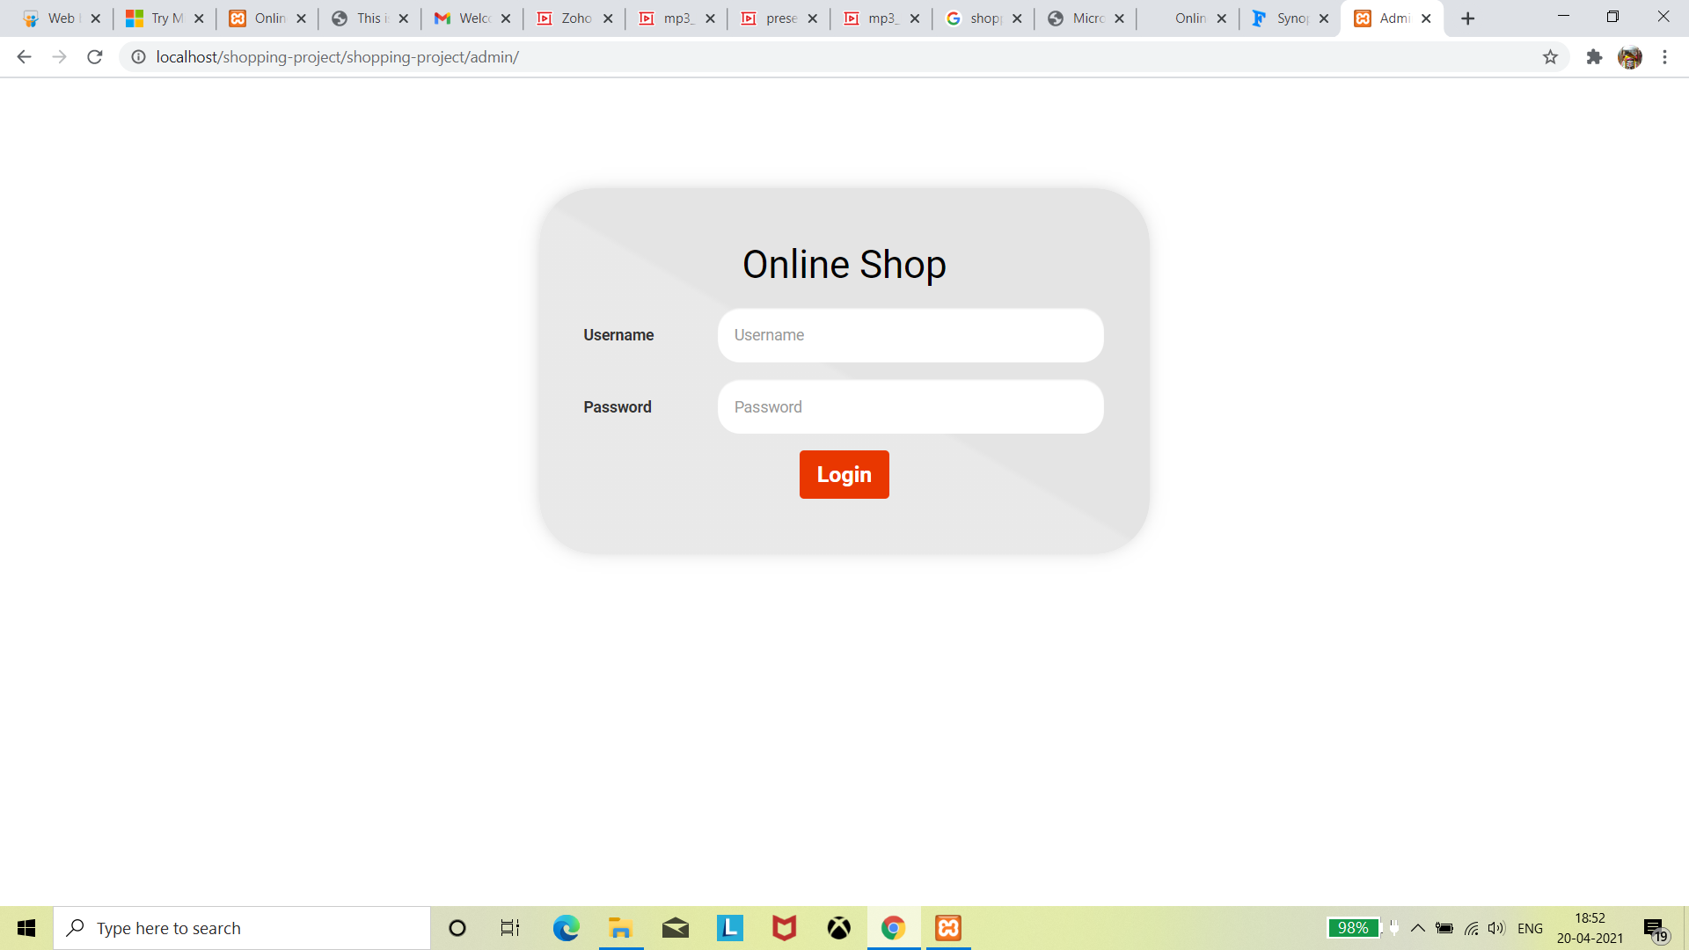
Login Admin panel

Slide 19
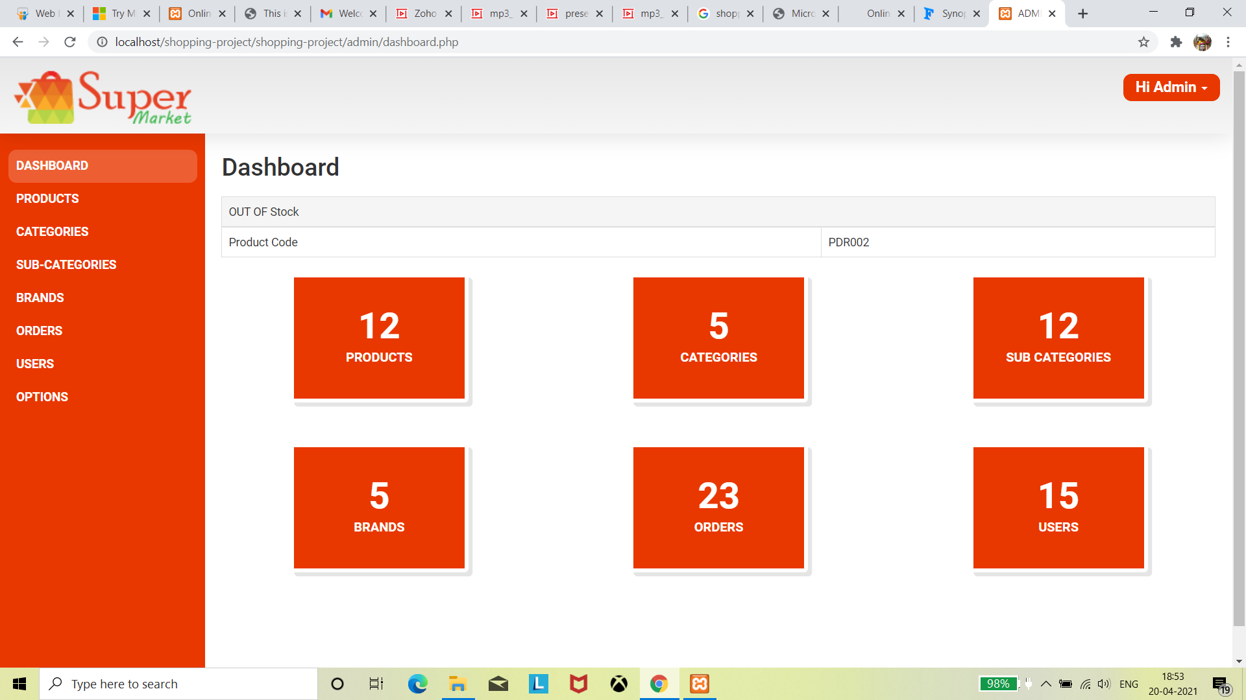
Admin panel- Dashboard

Slide 20
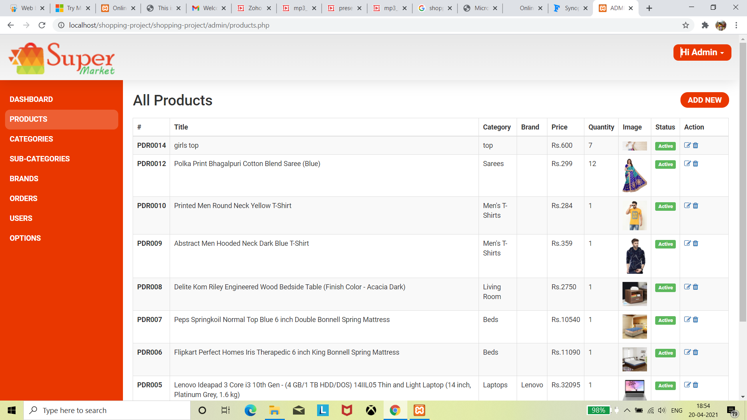
Admin panel- Product's detail

Slide 21
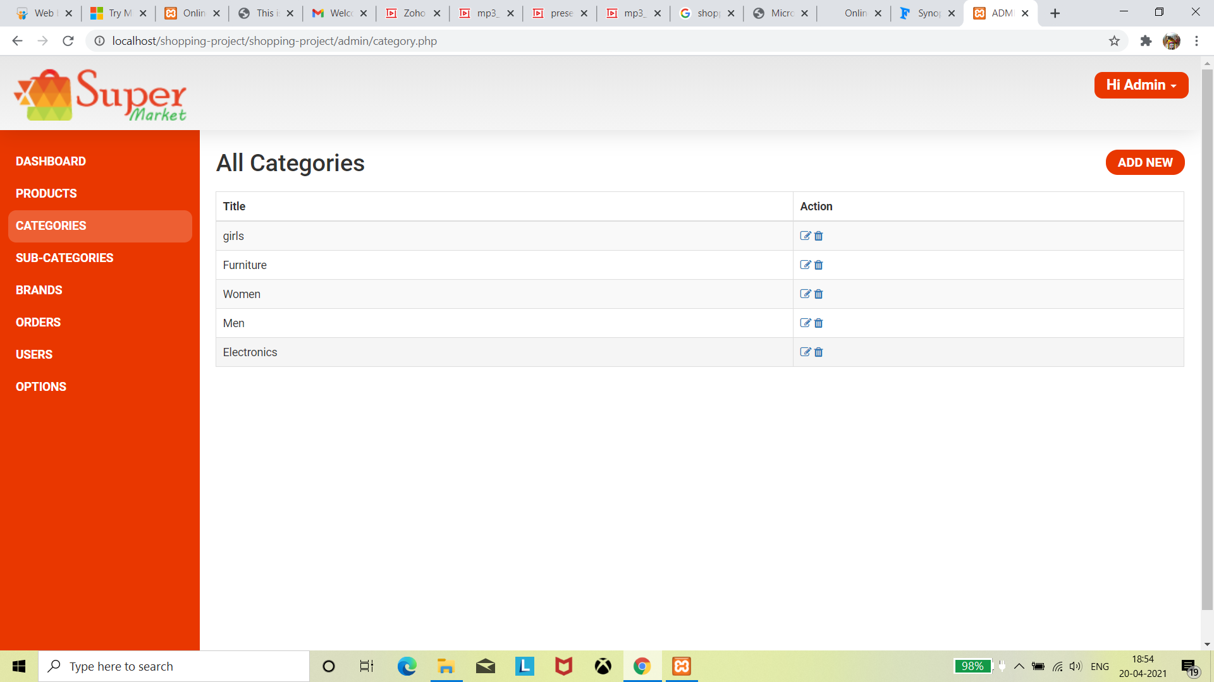
Admin panel- Categories detail

Slide 22
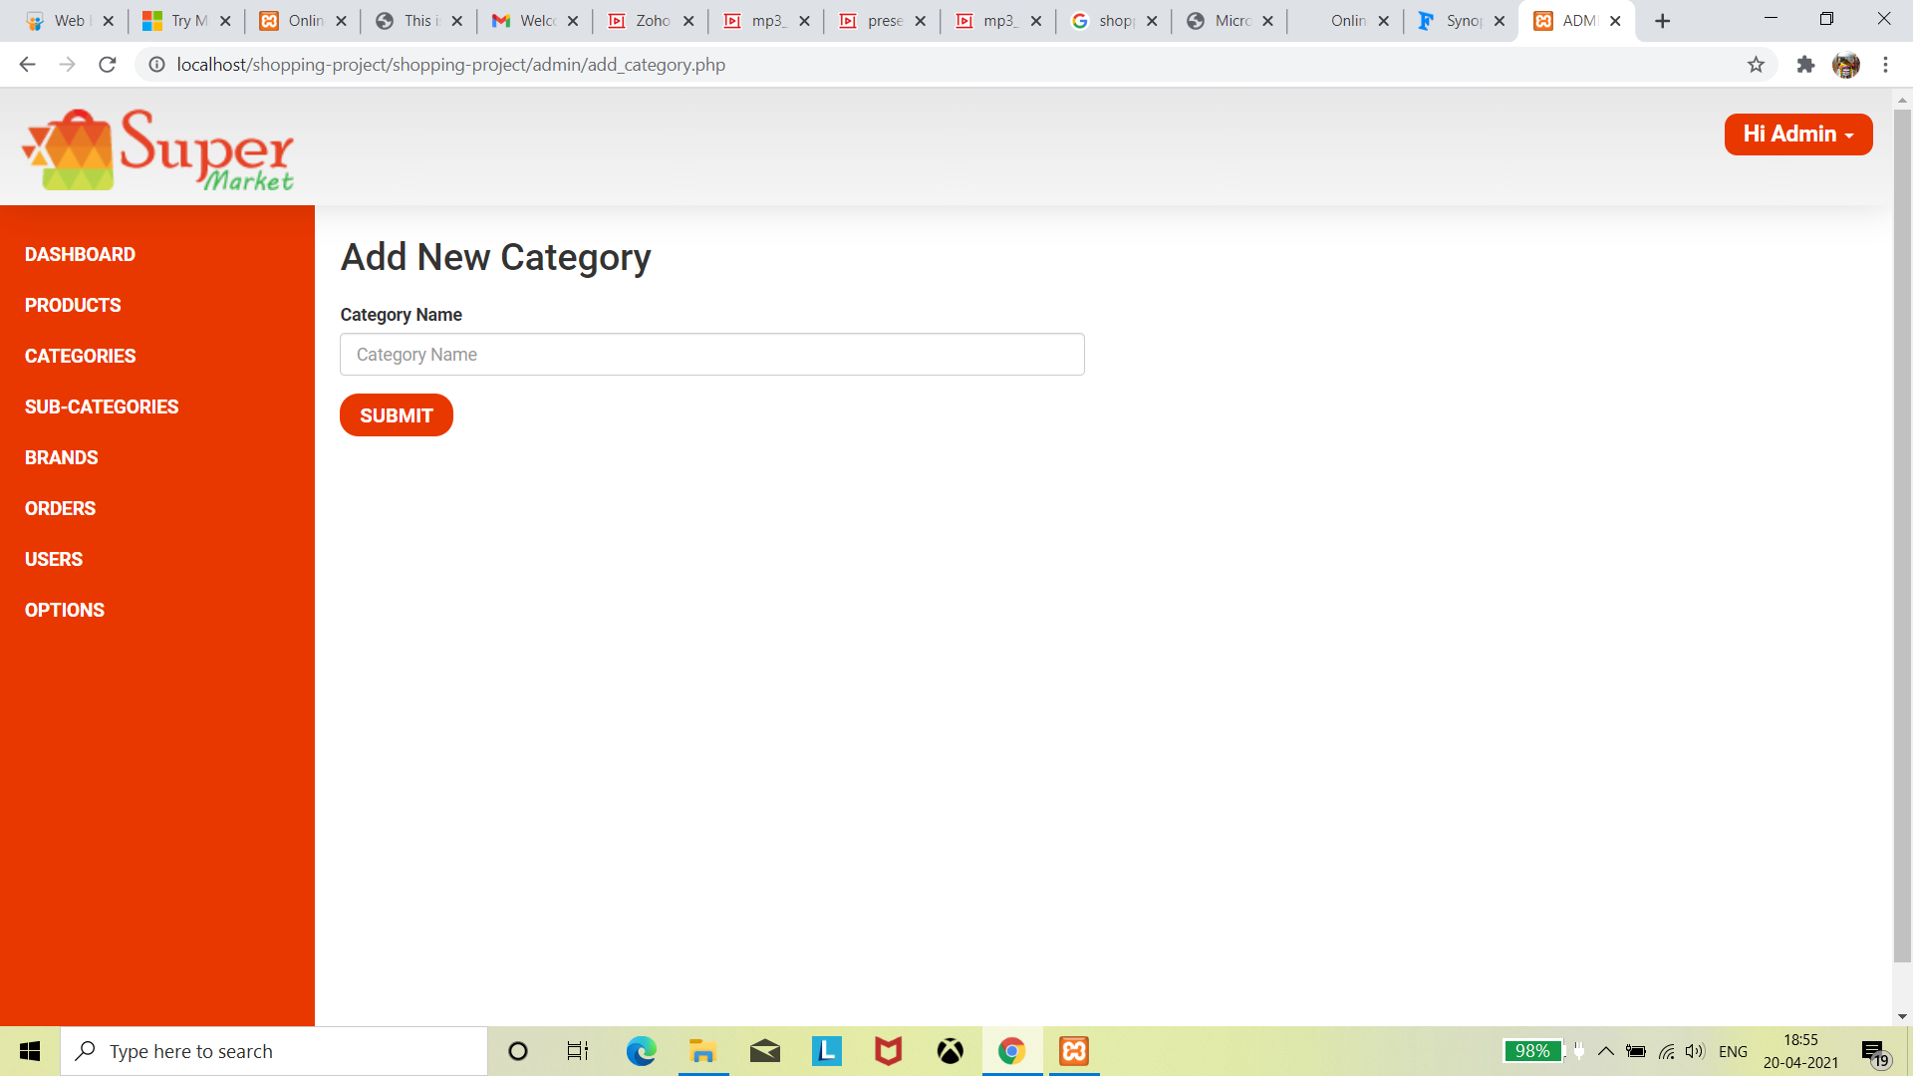
Add New Category

Slide 23
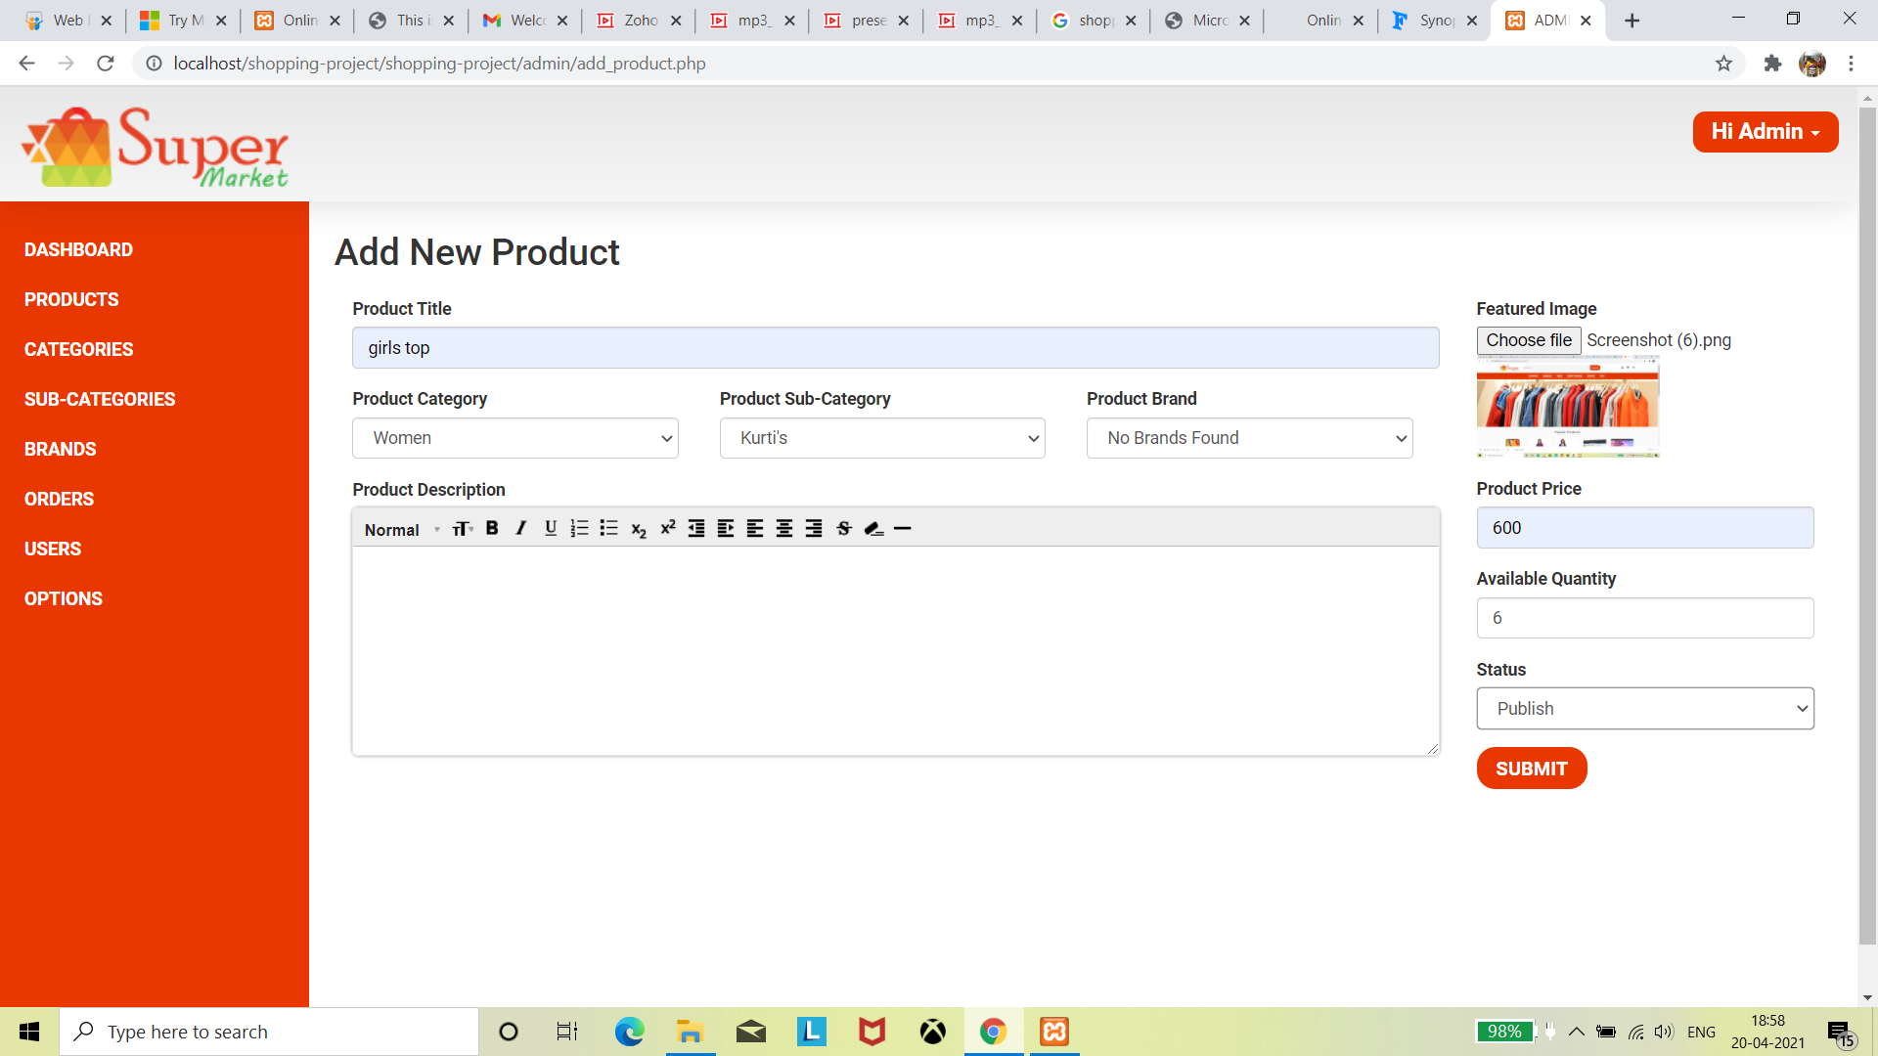
Add New Product

Slide 24
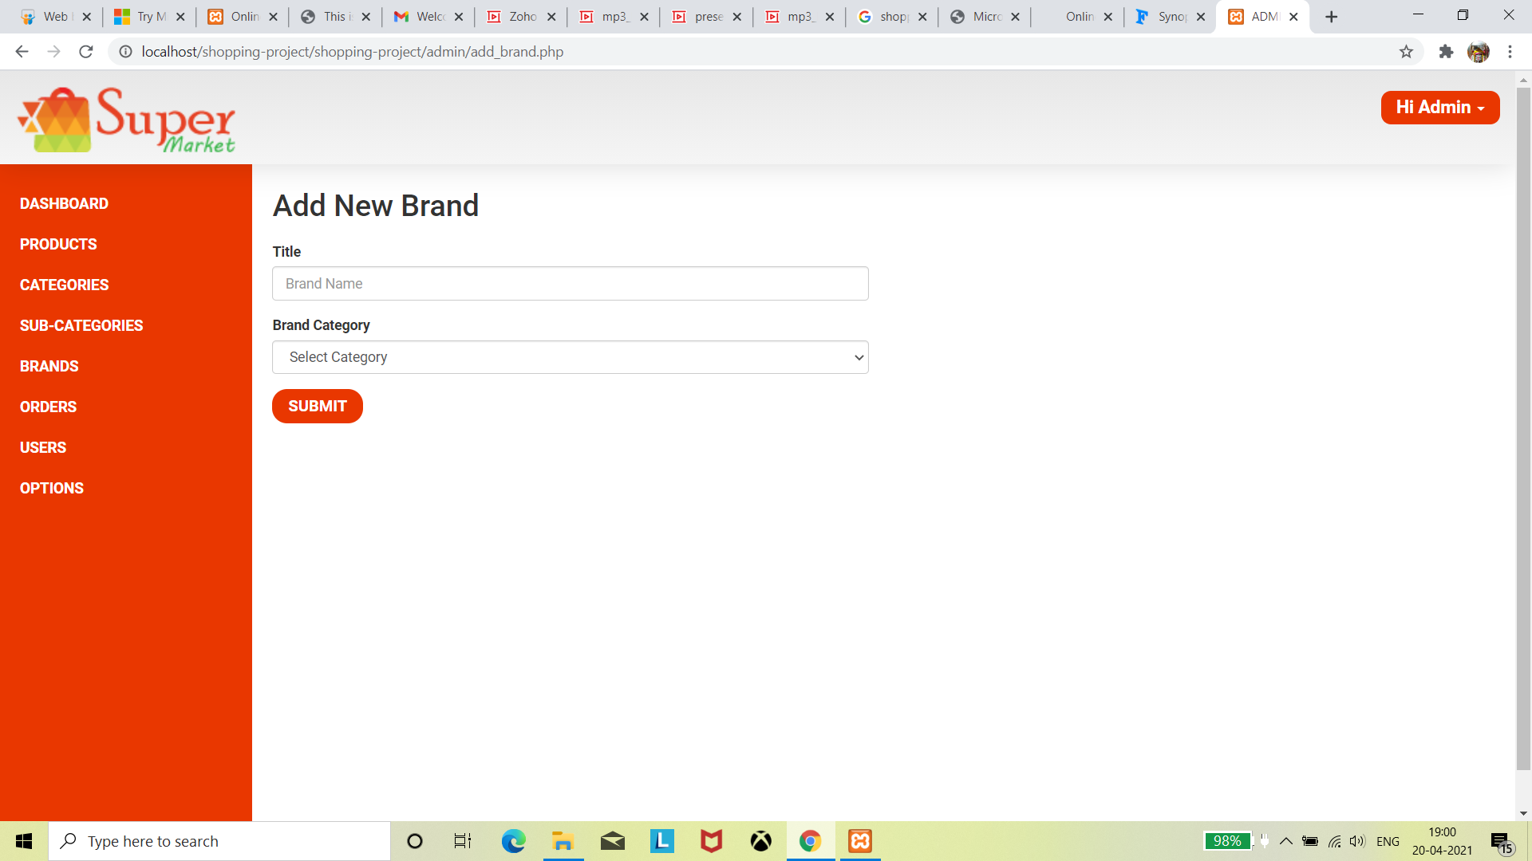
Add New Brand of product

Slide 25
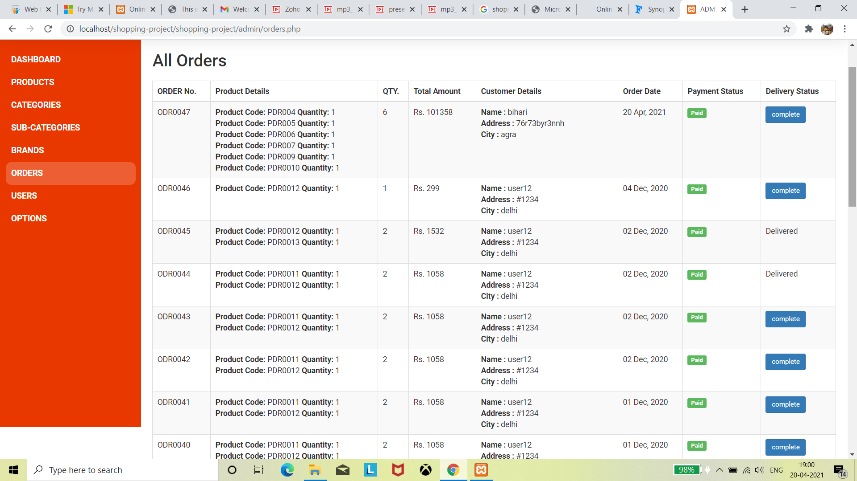
Admin panel- All orders

Slide 26
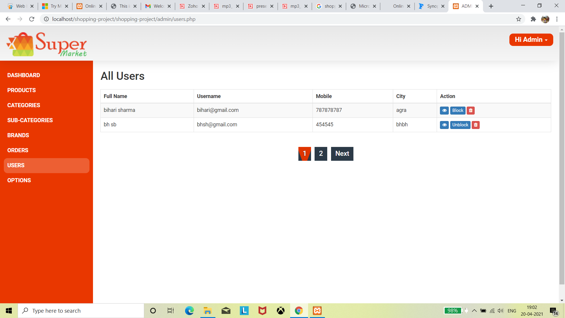
Admin panel- User's detail

Slide 27
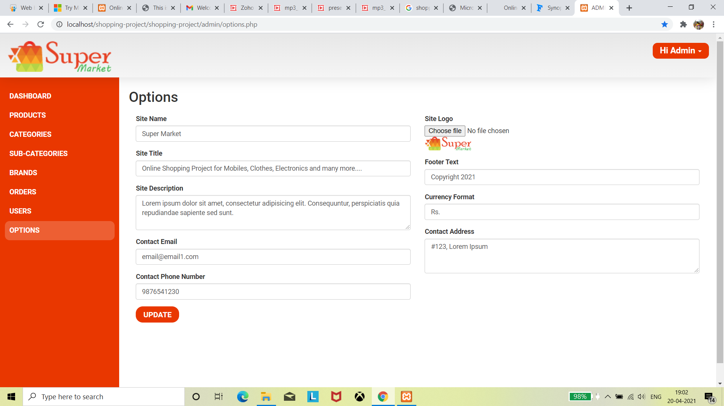

Slide 28


This will allow customers to place orders without even visiting the shop.
The admin can maintain and edit the products details and regularly update them in admin panel.
It is easy to run business fast with such type of system.
Online shopping become more enjoyable and easier than real-world shopping.
Being able to buy any time, any place,anywhere.

Slide 29




